Slide 1
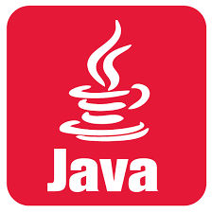

Slide 2
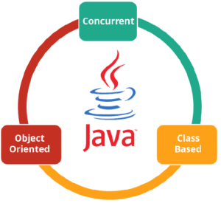
What is JAVA ?
Independent programming language that follows the logic of “Write once, Run anywhere”
Class-based and an object-oriented programming language.
Concurrent where you can execute many statements

Slide 3
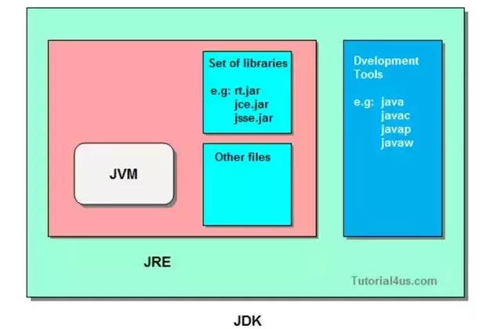
Components Of Java
JVM (Java Virtual Machine)
JRE (Java Runtime Environment)
JDK(Java Development Kit)

Slide 4
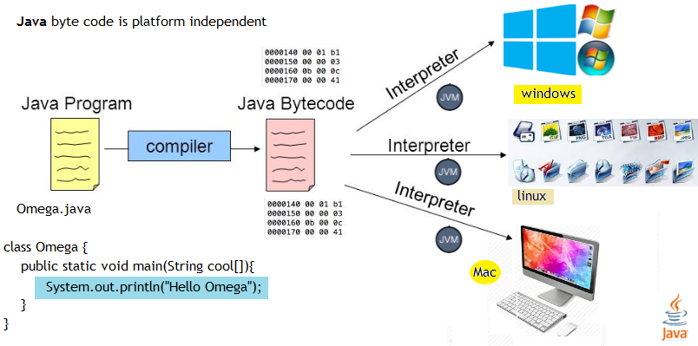
Java – Platform Independent

Slide 5
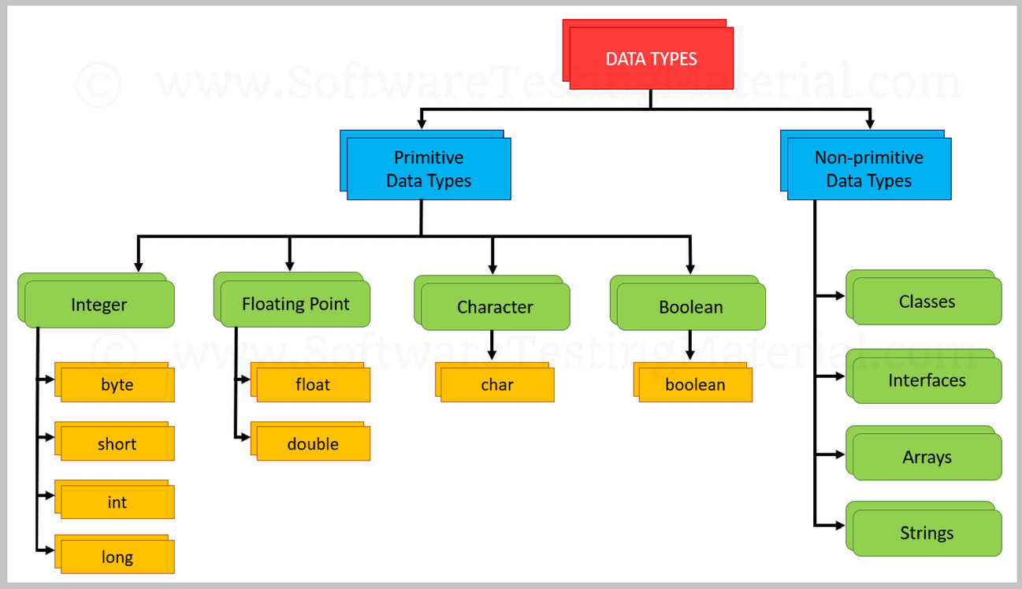
Java – Data Types

Slide 6
Java – My First HelloWorld Program
public class HelloWorld{
public static void main(String[] args) {
System.out.println(“Hello Welcome");
}
}

Slide 7
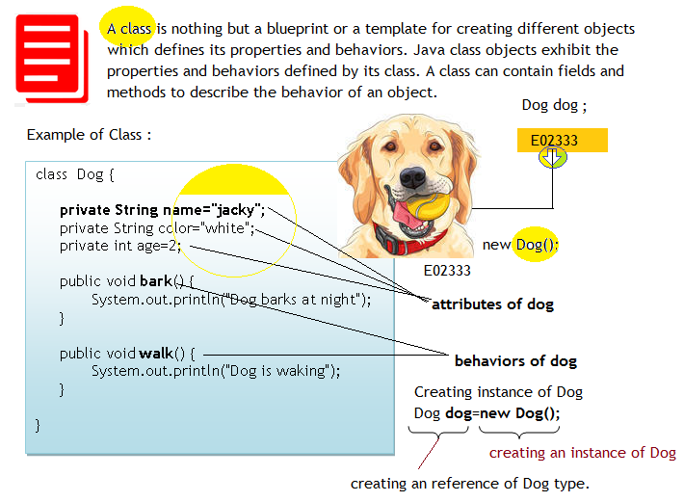
Java – Class

Slide 8
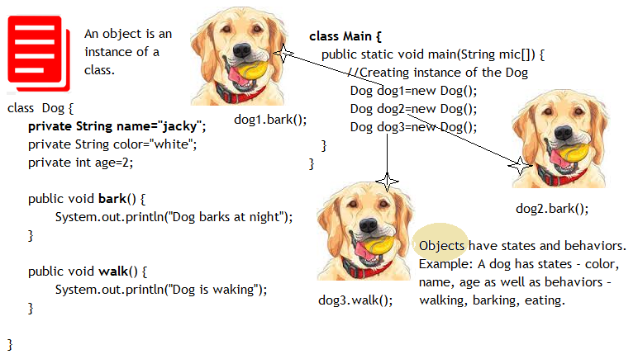
Java – Object

Slide 9
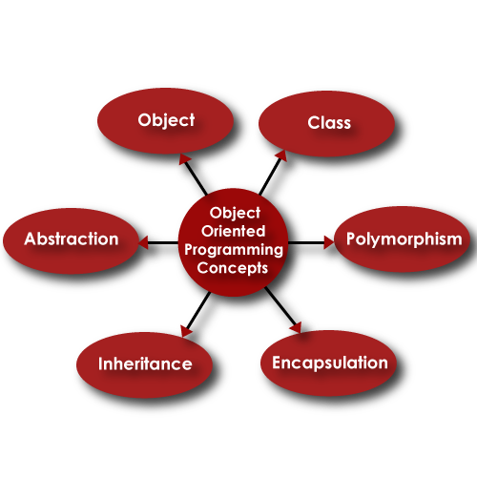
Java – OOPS Features

Slide 10
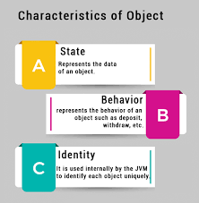
Java – Object

Slide 11
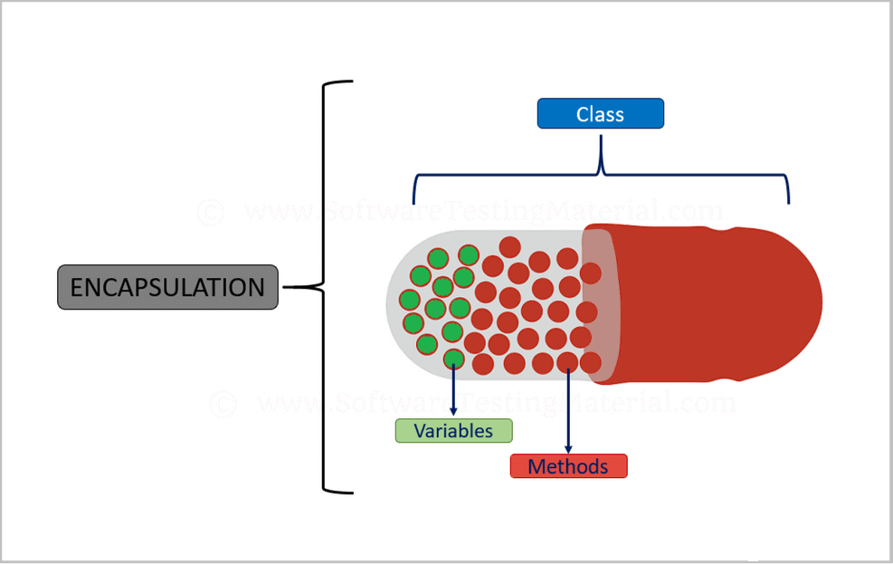
OOPS – Encapsulation

Slide 12
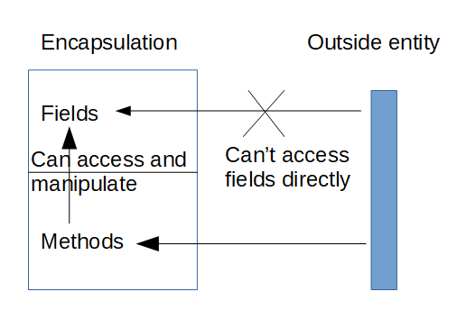
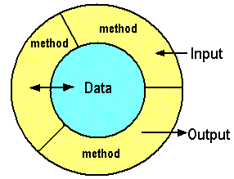
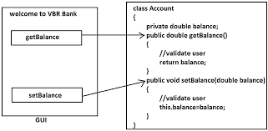

Slide 13
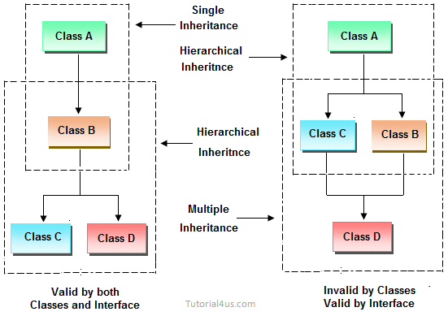
OOPS – Inheritance

Slide 14
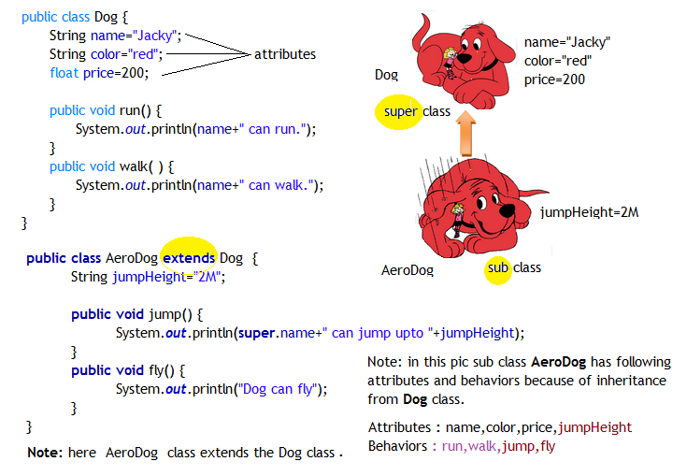
OOPS – Inheritance

Slide 15
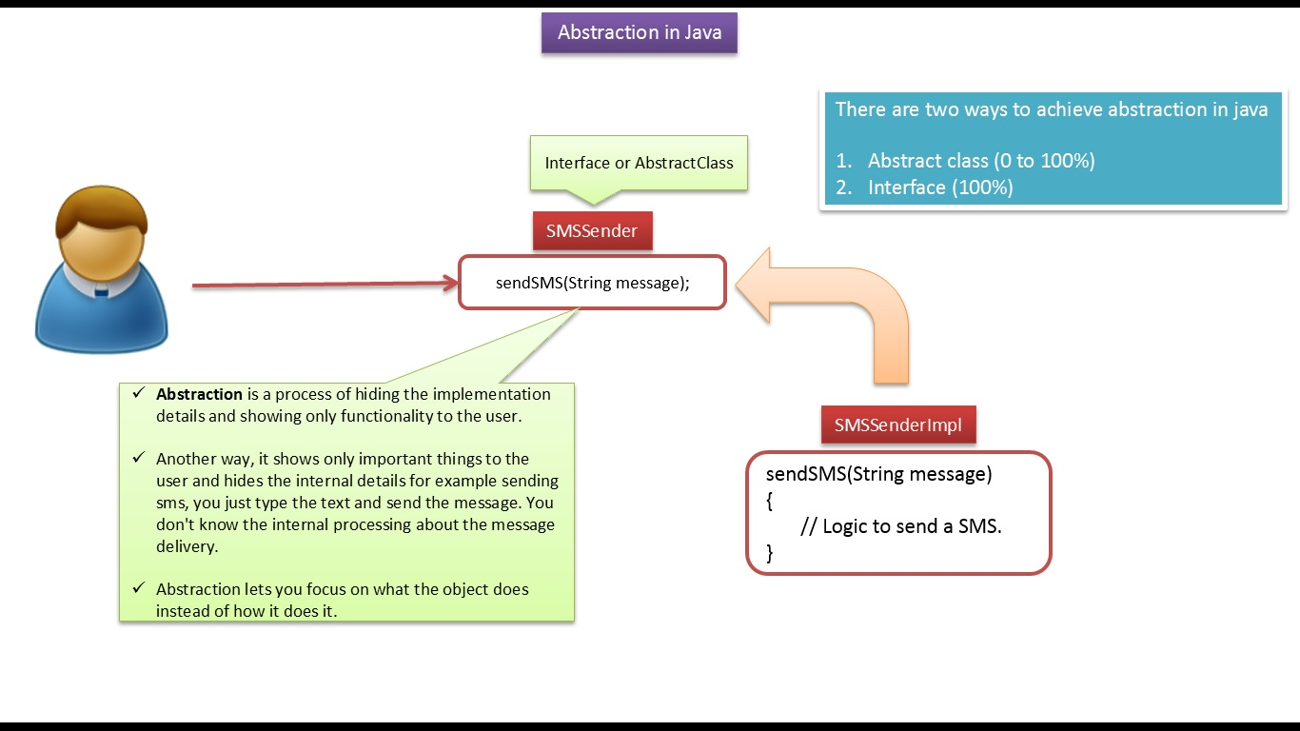
OOPS – Abstraction

Slide 16
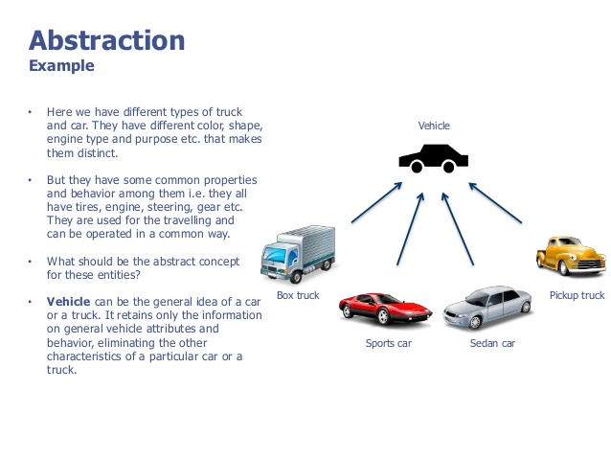
OOPS – Abstraction

Slide 17
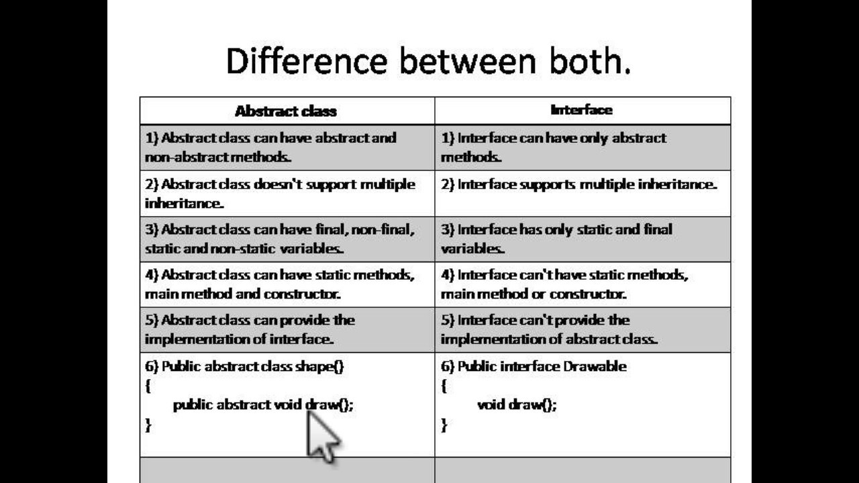
OOPS – Abstract Vs Interface

Slide 18
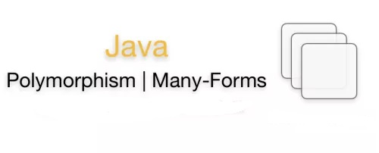

Slide 19
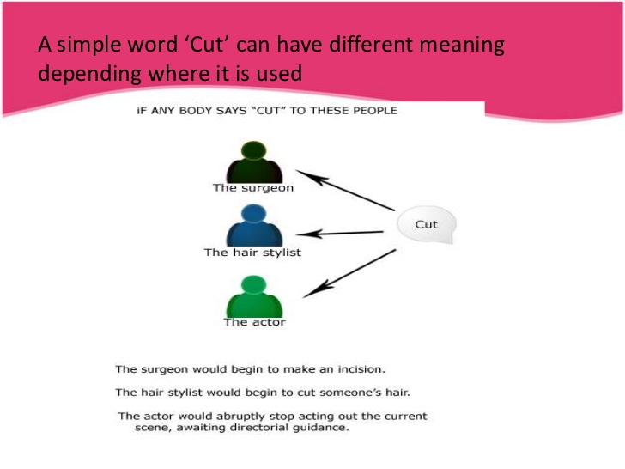
OOPS – Polymorphism

Slide 20
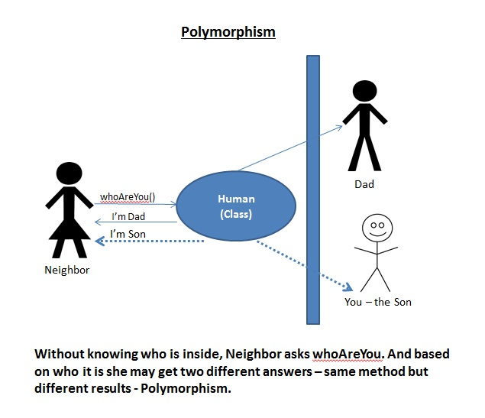
OOPS – Polymorphism

Slide 21
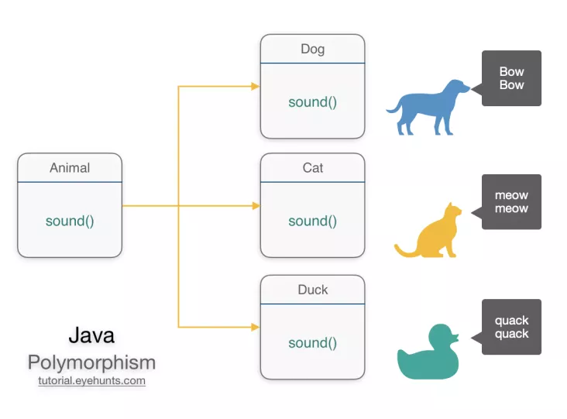
OOPS – Polymorphism
Polymorphism is one of the OOPs feature that allows us to perform a single action in different ways. For example, lets say we have a class Animal that has a method sound(). Since this is a generic class so we can’t give it a implementation like: Roar, Meow, Oink etc. We had to give a generic message.

Slide 22
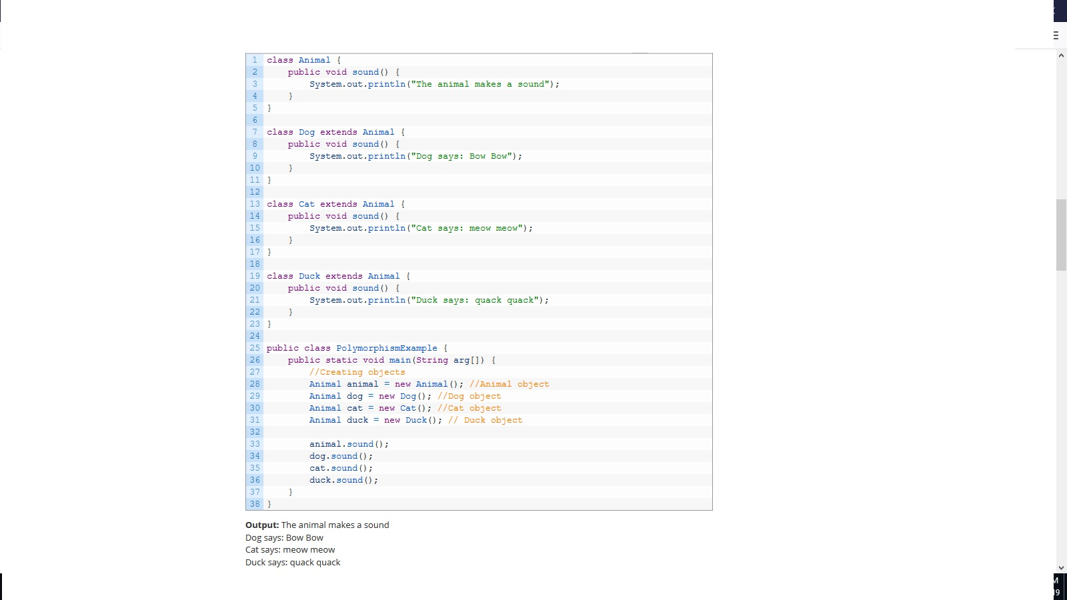
OOPS – Polymorphism

Slide 23
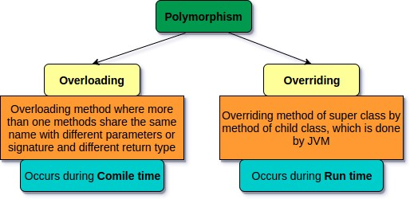
OOPS – Polymorphism

Slide 24
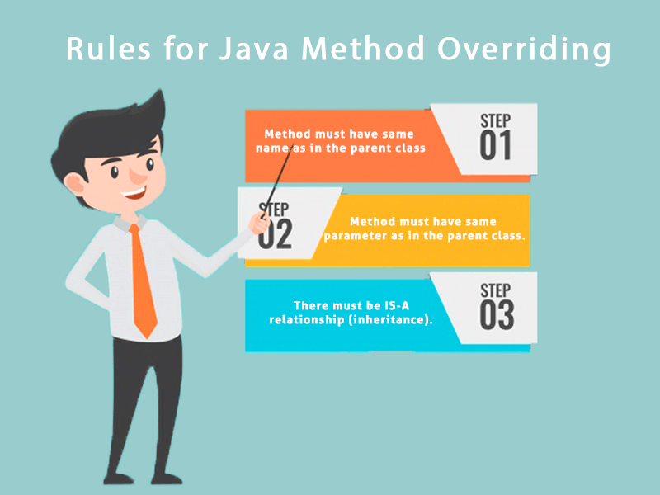
OOPS – Polymorphism - Overridding

Slide 25
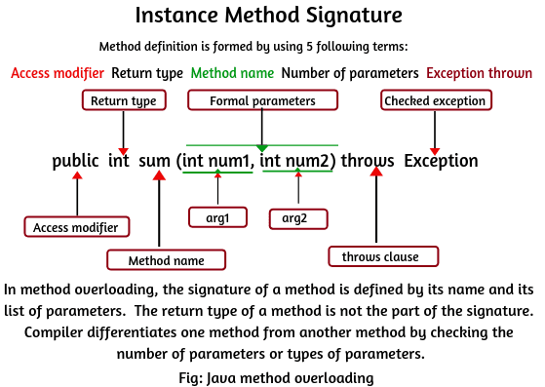
OOPS – Polymorphism - Overloading

Slide 26


